Slide 1

Helpful Health Literacy Resources
Toolkits, Websites, Conferences, State and National Data
Terry Davis, PhD
Connie Arnold, PhD

Slide 2
Content
  Health Literacy Research References (3 - 4)
  Health Literacy Toolkits (5 – 6)
  Health Literacy Resources for Healthcare Organizations (7)
  Health Literacy Websites (8 – 9)
  Patient Education Development (10)
  Formula to Evaluate Reading Level – Written Materials (11 – 12)
  Patient Education Materials (13)
  Literacy Tests Cited in Literature (14 – 15)
  Qualitative Assessment for Limited Health Literacy (16)
  Ordering Information (17)

Slide 3
Key Health Literacy References
US DHHS (2010) National Action Plan to Improve Health Literacy www.health.gov/communication/HLactionplan
US DHHS Healthy People 2020 www.healthypeople.gov
The Joint Commission (2008) Strategies for Improving Health Literacy from The Joint Commission Perspectives on Patient Safety. The Joint Commission: Oakbrook Terrace, Illinois
Institute of Medicine (2004) Health Literacy: A Prescription to End Confusion. In Nielson-Bohlman L, Panzer A, Kindig DA, eds. Washington, DC: National Academy Press
Schwartzberg JG (2005) Understanding health literacy: Implications for medicine and public health. AMA Press
Weiss BD (2003) Health Literacy: A Manual for Clinicians. AMA Foundation

Slide 4
Key Health Literacy References
Doak CC (1996) Teaching Patients with Low-Literacy Skills, 2nd ed. JB Lippincott
Koh H, et al (2013): Toward a Systems Approach To Health Literacy Research. J Health Commun: International Perspectives. 18(1):1-5
Koh H, et al (2012): New federal policy initiatives to boost health literacy can help the nation move beyond the cycle of costly “crisis care.” Health Affairs. 31:434-443
Johnson S, et al (2011): Back to basics: Why basic research is needed to create effective health literacy interventions. J Health Commun. 16(Suppl 3):22-29
Rudd R (2010): Improving Americans’ health literacy. N Engl J Med. 363:2283-2285
Zarcadoolas C, et al (2006): Advancing Health Literacy: A Framework for Understanding and Action. San Francisco, CA: Jossey-Bass

Slide 5
Health Literacy Toolkits
Agency Healthcare Research & Quality
  Informed Consent (2009)
  www.ahrq.gov/fund/informedconsent
  Health Literacy Universal Precautions (2010) - Clinic Based System
  www.ahrq.gov/qual/literacy/
  Project RED (ReEngineered Discharge) (2013) - Hospital Discharge www.bu.edu/fammed/projectred/newtoolkit/

Slide 6
Health Literacy Toolkits
Pharmacy Assessment Tools and Training
  AHRQ (2007)
  Strategies to improve communication between pharmacy staff and patients training program
  www.ahrq.gov/qual/pharmlit/pharmtrain.htm
Website Design
  HHS (2010)
  Health literacy online a guide to writing and designing easy to use health web sites
  www.health.gov/healthliteracyonline/Web_Guide_Health_Lit_Online.pdf

Slide 7
Resources for Healthcare Organizations
Institute of Medicine (2012 )
Ten attributes of Health literacy Healthcare Organizations
iom.edu/Global/Perspectives/2012/HealthLitAttributes.aspx
Health Literacy Environment of Hospitals & Health Centers (2006 )
www.hsph.harvard.edu/healthliteracy/
The Joint Commission (2007)
What did the doctor say? Improving health literacy to protect patient safety
National Qualify Forum (2009)
Health Literacy a linchpin in achieving national goals for health and healthcare
Communication Climate Assessment Tool (2010)
Wynia M: American Journal of Medical Quality

Slide 8
Health Literacy Websites
CDC
www.cdc.gov/healthliteracy
www.cdc.gov/healthliteracy/pdf/simply_put.pdf
NIH
www.nih.gov/icd/od/ocpl/resources/healthliteracyresearch.htm
UNC
www.nchealthliteracy.org/
Rima Rudd (Harvard School of Public Health)
www.hsph.harvard.edu/healthliteracy
Helen Osborne
www.healthliteracy.com/

Slide 9
Health Literacy Websites
Health Literacy Tools, Reports, and Research
www.health.gov/communication/literacy/#tools
Carolina Geriatric Education Center
www.med.unc.edu/aging/cgec/Health%20Literacy
CDC Expert Panel Report: HL for Older Adults
www.cdc.gov/healthliteracy/pdf/olderadults.pdf

Slide 10
Patient Education Development
CMS (2011)
Toolkit for making written materials clear and effective
https://www.cms.gov/writtenmaterialstoolkit/
CDC (2007)
Simply Put: A guide for creating easy-to-read print materials that your audience will be able to read and use, 3rd ed.,
NCI (2003)
Clear and simple developing effective print materials for low literacy readers
http://www.cancer.gov/cancertopics/cancerlibrary/clear-and-simple/page1
Seligman HK, Wallace AS, DeWalt DA, et al: (2007) Developing low-literacy patient educational materials to facilitate behavior change. Am J Health Behav. Sep-Oct;31 Suppl 1:S69-78.

Slide 11
Formula to Evaluate
Reading Level Written Materials
Flesch Kincaid Reading Level and Fesch Reading Ease:
  Automatically bundled with Microsoft Word
  Tests sentence complexity
Vocabulary Profiler
  Helps determine uncommon words
  Very useful for non-native English speakers
  http://www.sfu.ca/~msevier/WebVocabularyProfilerCS.htm

Slide 12
Formula to Evaluate
Reading Level- Written Materials
Lexile Level
  Analyzes both sentence complexity and word frequency
  http://www.lexile.com/analyzer/
Fry Readability Formula
  Randomly select three separate 100 word passages
  Count the number of sentences in each 100 word sample to the nearest tenth
  Count the number of syllables in each 100 word sample
  Plot the average sentence length and the average number of syllables on a Fry Graph to determine the grade level

Slide 13
Checklists to Evaluate User-Friendliness (Suitability)
Osborn H. (2004) Health Literacy from A to Z: Practical Ways to Communicate Your Health Message.2004
Arnold CL, Davis TC, Ohene Frempong J, et al (2006) : Assessment of newborn screening parent education materials. Pediatrics. 2006;117:320-5.
Doak CC. (1996) Teaching Patients With Low Literacy Skills, 2nd ed., 1996.
Rudd R. (1994) Learner developed materials: An empowering product. Health Education quarterly. (Fall) 1994.

Slide 14
Patient Education Materials
Institute for Healthcare Advancement
www.iha4health.org/default.aspx/MenuItemID/191/MenuGroup
  7 easy to read, easy to use guides to better health
  What to do…
    When your child gets sick
    When you’re having a baby
    For teen health
    For healthy teeth
American College of Physicians
www.acpfoundation.org/patients/guides.htm
  Helpful ways to lose weight
  Caring for your heart
End of Life Decision Making
Volandes AE (2010) Medical Decision Making. 30(1):29-34
    When your child has asthma
    When your child is heavy
    For senior health
  Living with diabetes
  Living with COPD

Slide 15
Literacy Tests Cited In Literature
Many now referred to as HL tests
TEST | YEAR | TYPE
WRAT – R3 | 65, 95 | Word recognition, math, spelling
REALM* | 91,93 | Health word recognition
TOFHLA* | 95 | Comprehension of health materials
S-TOFHLA* | 99 | Comprehension of 2 health forms
N.V.S. | 05 | Comprehension, numeracy interpretation food label
REALM – R | 03 | Health word recognition (11 words)
REALM – SF | 06 | Health word recognition (7 2o4ds)
REALM – Teen | 06 | Adolescent health word recognition
SAHLSA | O7 | Spanish word recognition and comprehension
* Highly predictive of health outcomes.

Slide 16
Qualitative Assessment for
Limited Health Literacy
How confident are you filling out medical forms by yourself?
Extremely – Quite A Bit – Somewhat – A Little Bit – Not At All
( 0 ) ( 1 ) ( 2 ) ( 3 ) ( 4 )
A score of “somewhat” or lower is associated with limited health literacy
Chew L, et al: Validation of Screening Questions for Limited Health Literacy
in a Large VA Outpatient Population. J Gen Intern Med. 23(5):561-6.

Slide 17
Ordering Information
WRAT
http://www3.parinc.com/products/product.aspx
REALM and REALM-Teen
tdavis1@lsuhsc.edu
TOFHLA
http://peppercornbooks.com/catalog
NVS
http://www.clearhealthcommunication.com/physicians-providers/newest-vital-sign.html

Slide 18
Key Testing References
Davis T, Kennen EM, Gazmararian JA, Williams MV. Literacy testing in health care research. In: Schwartzberg JG, VanGeest JB, Wang CC, eds. Understanding health literacy: Implications for medicine and public health. United States of America: AMA Press; 2005: 157-179
Berkman N, Davis TC, McCormack L. Health Literacy: What is it? Journal of Health Communication 2010; 15(S2)
White S. Assessing the Nation’s Health Literacy: Key concepts and findings of the National Assessment of Adult Literacy (NAAL). AMA Foundation, 2008

Slide 19
Original Citations for Test
REALM
Davis TC, et al. Rapid Estimate of Adult Literacy in Medicine: A shortened screening instrument. Fam Med 1993;25(6):256-60.
TOFHLA
Parker RM, et al. The test of functional health literacy in adults: a new instrument for measuring patients’ literacy skills. J Gen Intern Med. 1995;10:537-541.
REALM – R
Bass PF, et al. Residents' ability to identify patients with poor literacy skills. Acad Med. 2002 Oct;77(10):1039-41.

Slide 20
Original Citations for Test
REALM – SF
Arozullah AM, et al. Development and validation of the Rapid Estimate of Adult Literacy in Medicine (REALM) – Short Form. Medical Care. 2007; 45(11):1026-33.
REALM – TEEN
Davis TC, et al. Development and validation of the Rapid Estimate of Adolescent Literacy in Medicine (REALM) Teen: A tool to screen adolescents for below-grade reading in health care settings. Pediatrics. 2006; 118:1707-14.
NVS
Weiss BD, et al. Quick assessment of literacy in primary care: the newest vital sign. Ann Fam Med. 2005 Nov-Dec;3(6):514-22.

Slide 21
National & State
Literacy & Health Data
National Assessment of Adult Literacy
http://nces.ed.gov/naal/factsheets.asp
http://nces.ed.gov/naal/saal.asp
United Health Foundation
www.americashealthrankings.org/rankings
Annie E. Casey Foundation
http://datacenter.kidscount.org/
CDC
www.cdc.gov/healthliteracy/statedata/index.html

Slide 22
2013 Health Literacy Conferences
Institute for Healthcare Advancement
Irvine, California: May 8-10
iha4health.org
Health Literacy Institute (great conference)
Freeport, Maine: June 2-5
healthliteracyinstitute.net/
Boston University Health Literacy Annual Research Conference (HARC)
Washington, D.C.: October 28-29
www.bumc.bu.edu/healthliteracyconference/

Slide 23
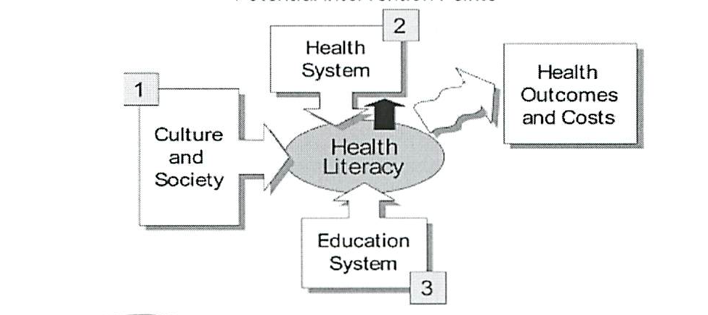
Research Opportunities
IOM Health Literacy Model Guides Intervention
  2004: PAR – NIH (13 institutes) and AHRQ issued program announcements focused on “Understanding and Promoting Health Literacy” (re-issued 2007, 2010)
IOM Report 2004

Slide 24
Consultation
Department of Medicine and Pediatrics, LSU Health Shreveport
Research Assistants
Terry Davis, PhD
TDavis1@lsuhsc.edu
(318) 675-8694
Connie Arnold, PhD
Carnol@lsuhsc.edu
(318) 675-4324
Cristalyn Reynolds, MA
CReyn1@lsuhsc.edu
(318) 675-4585
Robert C. Ross, BS
RRoss2@lsuhsc.edu
(318) 675-4584

