Slide 1
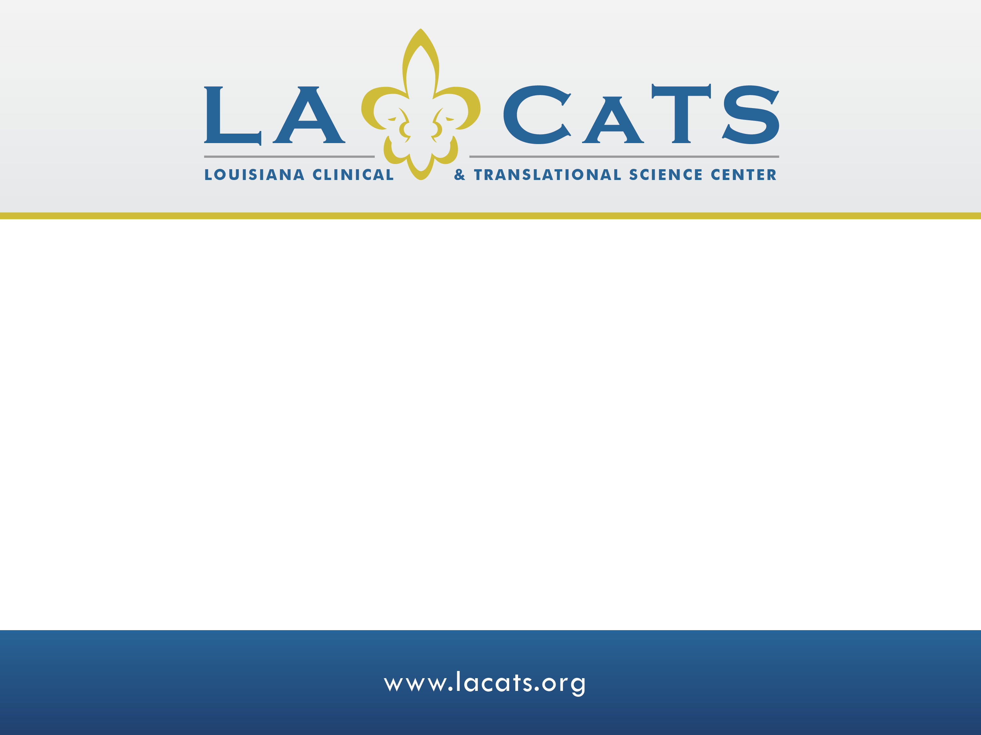
Assessing Literacy in Healthcare
Connie Arnold, PhD
Associate Professor of Medicine
Terry Davis, PhD
Professor of medicine and Pediatrics

Slide 2
Patient Literacy
Why Assess Patient Literacy?
  Literacy can be a barrier to patient’s ability to understand and act on instructions, forms and surveys
  People will NOT tell you if they cannot read well
  You CANNOT tell just by looking at a person
  Years of schooling is NOT a good measure of literacy level
    Reading comprehension may be 2 to 5 grade levels < education level
  In research, literacy is an easy, yet informative variable to add

Slide 3
Patient Literacy
How do I Measure Health Literacy?
  Several tests measure literacy in healthcare research
    Some have math sections
  All existing tests measure literacy in health context (i.e. not health literacy)
  These formal assessments provide a proxy measure of health literacy
  Can be used to compare results in the literature
  Patient’s score on literacy test is an indication they may struggle to understand and act on oral or written health information

Slide 4
Patient Literacy
What You Need to Know About Assessing Health Literacy
  Testing patient literacy level alone will NOT confirm ability to navigate, act, understand, and act on health information and manage care
  To get the most accurate measure of health literacy, use “teach back” method on patient’s need “to know and do” or measure knowledge, beliefs, behavior and self-efficacy
  No evidence that literacy testing improves health care delivery or outcomes when testing is done strictly for clinical use
  “Universal precautions” (plain language) are recommended to make materials user-friendly

Slide 5
Literacy Testing
Literacy Tests Used in Healthcare
  Several literacy tests have been used in healthcare research
  The 3 most commonly used tests are:
    REALM → Rapid Estimate of Literacy Medicine
    TOFHLA → Test of Functional Health Literacy
    NVS → Newest Vital Sign
  These are sometimes referred to as tests of health literacy

Slide 6
Literacy Testing
Considerations in Selecting Tests
  Reports in literature
  Validity/Reliability
  Cost
  Training required
  Ease of administration & scoring
  Time required
  Age and language of patients
  Enlarged print versions available

Slide 7
Literacy Testing
Literacy Tests Cited in Literature
  Many are now referred to as HL tests
TEST | YEAR | TYPE
REALM | 91, 93 | Health word recognition
TOFHLA* TOFHLA-S | 95 | Comprehension of health materials Spanish version
STOFHLA | 99 | Comprehension of two health forms
N.V.S. | 05 | Comprehension, numeracy interpretation food label
REALM-R | 03 | Health word recognition (11 words)
REALM-SF | 06 | Health word recognition (7 words)
SAHLSA | 07 | Spanish word recognition and comprehension

Slide 8
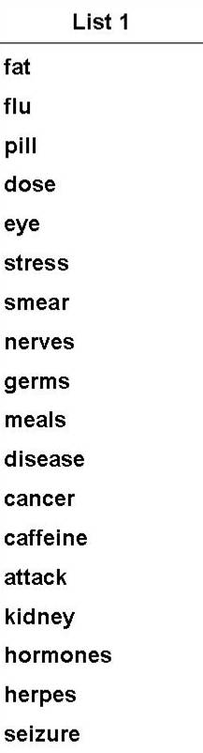
REALM
What is REALM?
  A 66 item word recognition test composed of
  common health words
  Available in English only
  Highly correlated with:
  WRAT (.88) SORT (.96)
  PIAT (.97) TOFHLA (.84)
  Time to administer test: ~ 2 minutes
  Translates into three grade levels:
    ≤ 6th grade (low literacy)
    7-8th grade (marginal literacy)
    ≥ 9th grade (adequate literacy)
Davis 1993, Fam Med
Notes:
Wide Range Achievement Test-Revised (r= 0.88)
revised Slosson Oral Reading Tests (r=0.96)
revised Peabody Individual Achievement Test (r=0.97)
TOFHLA (0.84)

Slide 9
List 1 | List 2 | List 3
fat flu pill dose eye stress smear nerves germs meals disease cancer caffeine attack kidney hormones herpes seizure bowel asthma rectal incest | fatigue pelvic jaundice infection exercise behavior prescription notify gallbladder calories depression miscarriage pregnancy arthritis nutrition menopause appendix abnormal syphilis hemorrhoids nausea directed | allergic menstrual testicle colitis emergency medication occupation sexually alcoholism irritation constipation gonorrhea inflammatory diabetes hepatitis antibiotics diagnosis potassium anemia obesity osteoporosis impetigo

Slide 10
REALM
Commonly Asked Questions About the REALM
  Pronunciation of endings must be 100% accurate
  Accent – Use your judgment
  Language other than English
    Not proven in other languages
  Do I need permission to use?
    No, it is in the public domain. It costs $65 for the manual (free for LACaTS members)

Slide 11
Short REALMs: REALM-R
REAL-R (2002)
  Correlations: REALM (.72), WRAT-R3 (.64)
  Score of ≤ 6 = risk for low literacy
  11 words (only 8 are scored) – fat, flu, and pill are not scored
  Fat
  Flu
  Pull
  Allergic
  Jaundice
  Anemia
  Fatigue
  Directed
  Colitis
  Constipation
  Osteoporosis

Slide 12
Short REALMs: REALM-SF
REAL-SF (2007)
  Correlations: REALM (.94), WRAT-R3 (.83)
  Score:
    0 – 3 ≤ 6th grade (low literacy)
    4 – 6 7-8th grade (marginal literacy)
    7 ≥ 9th grade (adequate literacy)
  7 words
  Menopause
  Antibiotics
  Exercise
  Jaundice
  Rectal
  Anemia
  Behavior

Slide 13
TOFHLA
What is TOFHLA?
  3 reading comprehension sections (Cloze technique)
  1 numeracy section
  Available in English and Spanish
  Correlations:
  WRAT (0.74) REALM (0.84)
  Long and short versions are available
    Time to administer TOFHLA: 22 minutes
    S-TOFHLA: 7 minutes
Parker 1995, J Intern Med

Slide 14
TOFHLA
TOFHLA Translates into three categories
  Inadequate functional health literacy
  Marginal functional health literacy
  Adequate functional health literacy
Parker 1995, J Intern Med

Slide 15
STOFHLA
PASSAGE A
Your doctor has sent you to have a ____________ X-ray.
a. stomach
b. diabetes
c. stitches
d. germs
You must have an __________ stomach when you come for ______.
a. asthma a. is.
b. empty b. am.
c. incest c. if.
d. anemia d. it.
Baker 1999, Patient Ed and Couns

Slide 16
STOFHLA
PASSAGE A CONT’D
The X-ray will ________ from 1 to 3 _________ to do.
a. take a. beds
b. view b. brains
c. talk c. hours
d. look d. diets
THE DAY BEFORE THE X-RAY.
For supper have only a ________ snack of fruit, ________ and jelly, with coffee or tea.
a. little a. toes
b. broth b. throat
c. attack c. toast
d. nausea d. thigh
Baker 1999, Patient Ed and Couns

Slide 17
TOFHLA-S (Spanish)
Lectura A
Su doctor le ha ____________ a sacarse Rayos X del ______________.
a. distinguido a. estómago
b. mandado b. caminar
c. corrido c. vestido
d. formalmente d. comunmente
Cuando venga por los ___________ debe de tener el estómago ___________.
a. libros a. volar
b. fiel b. cabeza
c. rayos x c. vacío
d. dormir d. contento
Parker 1995, J Intern Med

Slide 18
TOFHLA-S (Spanish)
Lectura A
Este examen de Rayos X _____________ de 1 a 3 ____________.
a. durará a. millas
b. cantará b. luz
c. permanente c. rayos x
d. silla d. horas
El día antes de ____________ radiografía, cene solamente alguna
a. del
b. alguna
c. la
d. botón
Parker 1995, J Intern Med

Slide 19
NVS
Newest Vital Sign
  6 question ice-cream nutrition label test
  General literacy test & numeracy skills test
  Moderate correlation with:
  REALM (0.41) TOFHLA (0.61)
  Available in English and Spanish
  Time to administer test: 5 – 7 minutes
  Translates into 3 levels: inadequate, marginal, or adequate literacy
Weiss 2005, Ann Fam Med

Slide 20
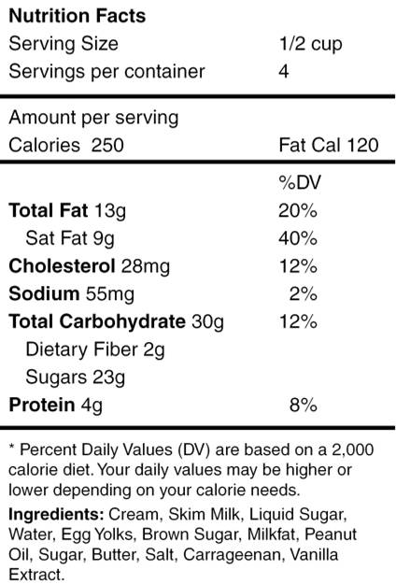
NVS
Example
  If you are allowed to eat 60g of carbohydrates as a snack how much ice cream could you have?
Score
  Give 1 point for each correct answer
  0 – 1 Inadequate Literacy
  2 – 3 Marginal Literacy
  4 – 6 Adequate Literacy

Slide 21
Qualitative Assessment
 | Year | Type
3 questions* | 04 | Self Report
1 question | 08 | Self Report
How confident are you in filling out medical forms by yourself?
Extremely 4 | Quite a lot 3 | Somewhat 2 | A little bit 1 | Not at all 0
  Highly correlated with REALM (.72 - .84) & S-TOFHLA (.66-.74)
  Self-report not more predictive than demographics (age, race, education)
  Score ≤ 2 = limited health literacy
Chew 2008, JGIM; Morris 2006, BMC Family Practice

Slide 22
Advantages & Disadvantages
 | REALM | TOFHLA | NVS | Chew
Age Range | > 18 years | Adults only | Adults only | Adults only
Advantages | Quick, non-threatening; large font size available | Measures comprehension; available in short and very short forms and in Spanish | Includes numeracy interpretation; May be best with college grads | Quick, non-threatening; Can be given over phone
Limitations | Does not discriminate above 9th grade; gives grade range estimates, not specific grade | Long versions that include numeracy test are time consuming | Limited use in literature | Self-report

Slide 23
Considerations
Considerations BEFORE Testing
  General
    How will you use the results?
    Who will give the test? When and where?
    Confidentiality (will score be in chart?)
  Patient
    Vision/Hearing
    Cognitive function
    Does the patient feel ill?
    Timing (did patient just receive bad news?)

Slide 24
Considerations
Be Prepared
  What will you say to patients to explain what you’re doing?
  What will you say if a patient asks how they are doing during or after the test?
  Practice giving the test before actually using it
  Be sure medical assistant or clerk has the adequate skills to administer

Slide 25
Considerations
Be Sensitive to Patient’s Shame
  Most adults and students with low literacy feel ashamed and try to hide it
  Testing may force exposure – expose vulnerability
  Non-verbal communication:
    What is your body language, facial expression, and voice tome communicating during and after the test?

Slide 26
Cautions
Developers of commonly used tests…
  Recommend that testing be limited to research or for testing clinical populations to develop appropriate materials
  Do not recommend testing patients clinically UNLESS providers are willing to alter communication and education based on findings

Slide 27
Patient Testing
Testing in Healthcare Bottom Lines
  Assessment of patient literacy in health care settings is an emerging field – current instruments are 1st steps
  Patient’s score on literacy test is an indication they may struggle to understand and act on oral or written health information
  A patient’s ability to understand and act on oral or written health information may involve processing speed, attention, memory, reasoning, numeracy, reading, verbal fluency

Slide 28
Tests Appropriate for Pediatrics

Slide 29
Tests
Tests for Children & Adolescents
  WRAT-R
    Wide Range of Achievement Test
    Ages 5 – 75
  REALM-Teen
    Rapid Estimate of Adolescent Literacy in Medicine
    Ages 12 - 18

Slide 30
WRAT-R3
What is WRAT-R3?
  Word recognition test – spelling and arithmetic sections
  Available in English only
  2 versions to allow pre- and post-testing
  Time to administer test: 3 – 5 minutes
  Difficult for low-level readers (and all of us)
  (assuage, terpsichorean)

Slide 31
WRAT-R3
Raw score gives grade equivalent:
  0 – 12 Pre-School
  13 – 18 Kindergarten
  19 – 23 1st Grade
  24 – 28 2nd Grade
  29 – 31 4th Grade
  32 – 34 5th Grade
  35 – 36 5th Grade
  37 – 38 6th Grade
  39 7th Grade
  40 – 41 8th Grade
  42 – 47 High School
  48 – 57 Post HS

Slide 32
WRAT-R3
A B O S E R T H U P I V Z J Q
IN | CAT | BOOK | TREE
HOW | ANIMAL | EVEN | SPELL
FINGER | SIZE | FELT | SPLIT
LAME | STRETCH | BULK | ABUSE
CONTEMPORARY | COLLAPSE | CONTAGIOUS | TRIUMPH
ALCOVE | BIBLIOGRAPHY | HORIZON | MUNICIPAL
UNANIMOUS | BENIGN | DISCRETIONARY | STRATAGEM
SEISMOGRAPH | HERESY | ITINERARY | USURP
IRASCIBLE | PSEUDONYM | OLIGARCHY | COVETOUSNESS
HEINOUS | EGREGIOUS | OMNISCIENT | ASSUAGE
DISINGENUOUS | TERPSICHOREAN

Slide 33
REALM-Teen
What is REALM-Teen?
  66 word recognition test
  Developed for adolescents age 12 – 18
  Used words from AAP materials
  Highly correlated with:
  WRAT (.83) SORT (.93)

Slide 34
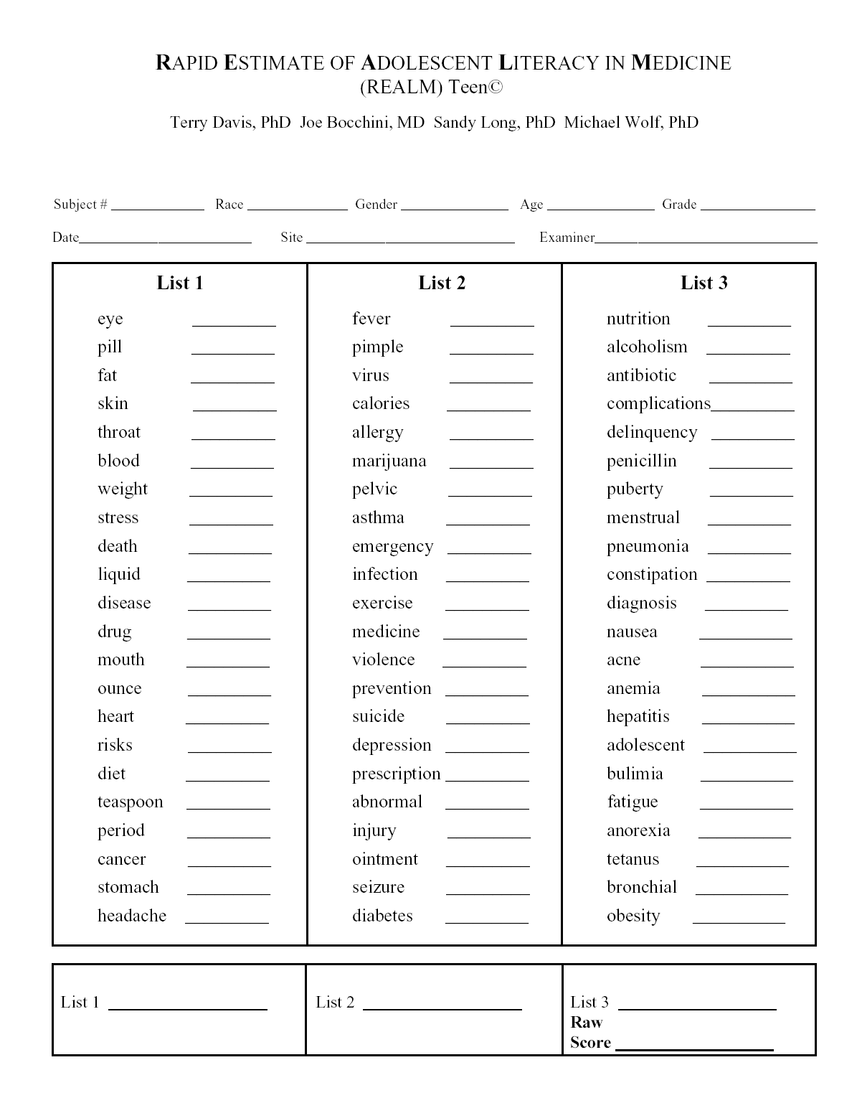

Slide 35
REALM-Teen
Scoring
  Raw score = total number of correctly pronounced words
  Dictionary pronunciation is the scoring standard
Raw Score | Grade Range Equivalent | Literacy Skills
0-37 | < 3rd Grade | These adolescents will have a 5 fold likelihood of reading below grade level. They may be at risk of school failure.
38-44 | 4th - 5th Grade
45-58 | 6th - 7th Grade | Will struggle with most patient education materials; may have skills to pass GED.
59-62 | 8th - 9th Grade
63-66 | > 10th Grade | Will be able to read most patient education materials.

Slide 36
Ordering Information
REALM and REALM-Teen
  tdavis1@lsuhsc.edu
TOFHLA, TOFHLA-Spanish and STOFHLA
  http://peppercornbooks.com/catalog
NVS
  http://www.clearhealthcommunication.com/physicians-providers/newest-vital-sign.html
WRAT
  http://www3.parinc.com/products/product.aspx

Slide 37
Key References
  Davis T, Kennen EM, Gazmararian JA, Williams MV. Literacy testing in health care research. In: Schwartzberg JG, VanGeest JB, Wang CC, eds. Understanding health literacy: Implications for medicine and public health. United States of America: AMA Press; 2005: 157-179.
  White S. Assessing the Nation’s Health Literacy: Key concepts and findings of the National Assessment of Adult Literacy (NAAL). AMA Foundation, 2008.

Slide 38
Original Citations
REALM
  Davis TC, et al. Rapid Estimate of Adult Literacy in Medicine: A shortened screening instrument. Fam Med 1993;25(6):256-60.
REALM-R
  Bass PF, et al. Residents' ability to identify patients with poor literacy skills. Acad Med. 2002 Oct;77(10):1039-41.
REALM-SF
  Arozullah AM, et al. Development and validation of the Rapid Estimate of Adult Literacy in Medicine (REALM) – Short Form. Medical Care. 2007; 45(11):1026-33.
REALM-Teen
  Davis TC, et al. Development and validation of the Rapid Estimate of Adolescent Literacy in Medicine (REALM) Teen: A tool to screen adolescents for below-grade reading in health care settings. Pediatrics. 2006; 118:1707-14.

Slide 39
Original Citations Cont’d
NVS
  Weiss BD, et al. Quick assessment of literacy in primary care: the newest vital sign. Ann Fam Med. 2005 Nov-Dec;3(6):514-22.
Qualitative Assessment
  Chew LD, et al. Validation of screening questions for limited health literacy in a large VA outpatient population. J Gen Intern Med. 2008 March;23(5):561-6.
TOFHLA and TOFHLA-S
  Parker RM, et al. The test of functional health literacy in adults: a new instrument for measuring patients’ literacy skills. J Gen Intern Med. 1995;10:537-41.
STOFHLA
  Baker DW, et al. Development of a brief test to measure functional health literacy. Patient Education and Counseling. 1999;38:33-42.

