Slide 1

Strategies to Make Informed Consent Truly Informed
Terry Davis, PhD
Connie Arnold, PhD

Slide 2
Consent Form Issues
What’s the problem with our current consent forms?
  Too lengthy
  Requires a reading level above audience capacity
  Complex sentences and phrases
  Page density (lack of white space)
  IRBs do not meet their own standards for readability
  Patients do not understand basic concepts being explained

Slide 3
Literacy
Why is Literacy an Issue?
  Patient education level is not a good indicator of literacy level
  Patients read 3 to 4 grades under education level completed
  Patients are usually not willing to inform you of difficulty reading
  Louisiana ranks 49th nationally among states in literacy
    Statistics for adults who read at or below 5th grade level.
                28% Baton Rouge Adults
                39% New Orleans Adults
                28% Shreveport Adults
    *Rates are double for those with chronic disease, age > 65, low income and minority groups
    *According to the National Assessment of Adult Literacy

Slide 4
Consent Form Goals
What do we want from informed consent?
  Forms that tell patients about the research
  Forms in terms that are easy to understand
  To enable discussion between patient and researcher

Slide 5
Consent Form Checklist
How useful is your consent form?
  Can patients read and understand it?
  Does it help patients make a decision about participation in the study?
  Is it written in plain language?
  Is it formatted for reading ease?
  Is the information included manageable or overwhelming?

Slide 6
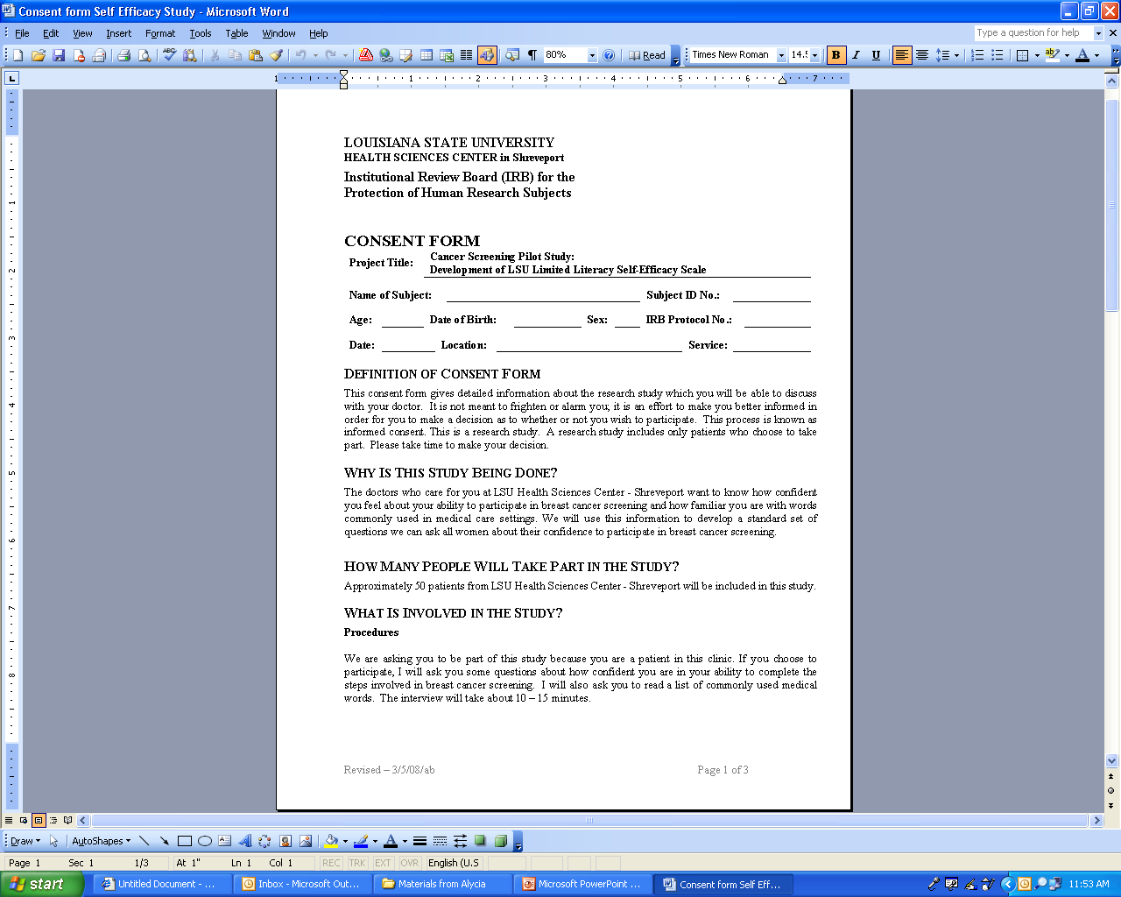
Reading Level
How to Assess Reading Level
  Flesch-Kincaid Tool
    On your computer
    Estimates difficulty of reading form
  Aim for <8th grade reading level

Slide 7
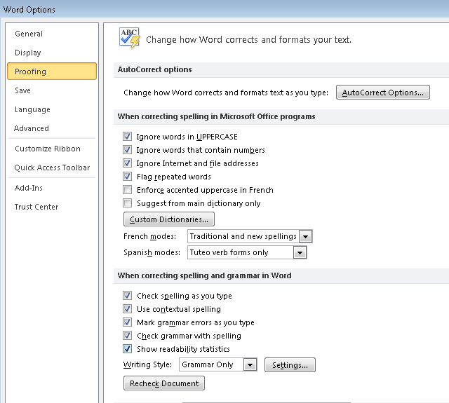
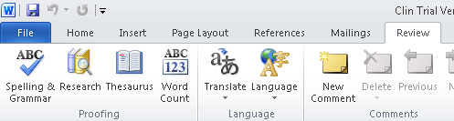
Flesch-Kincaid
How to Turn on Readability Statistics
Microsoft 2007 & 2010
  Go to File Tab; select Options
  Click on Proofing
  Check “Show Readability Statistics”
  Click Ok then go to Review Tab
  Select Spelling & Grammar
Readability Results will show after spelling has been checked

Slide 8
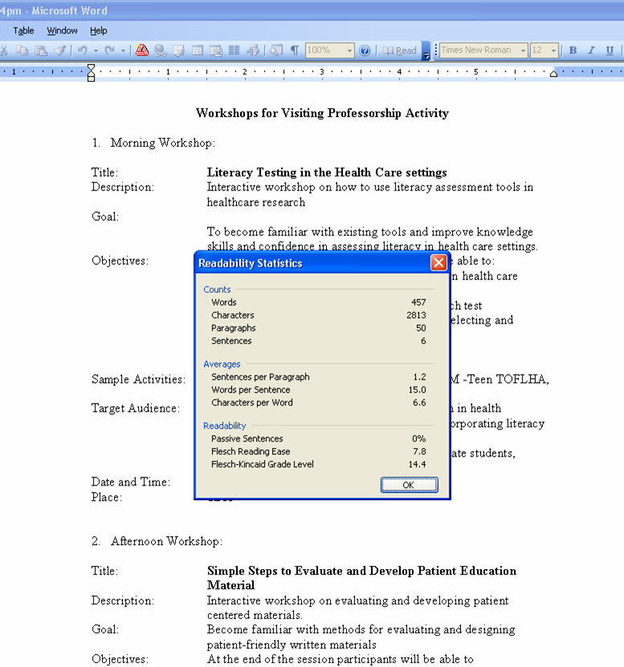
Flesch-Kincaid
How to Turn on Readability Statistics
Microsoft 2003
  Go to Tools/Review
  Select Spelling
  Select Options
  Check “Readability Statistics”

Slide 9
Lexile
Lexile Analyzer
  An internet program that calculates the Lexile score for each sample
  Scores based on sentence length and word frequency in popular literature
  Higher values indicate higher levels of reading difficulty
  Scores range from below 0 (beginner level) to 2000
  Aim for <900

Slide 10
Lexile
Instructions
  Save Consent Form text as a Plain Text File
  Go to www.lexile.com
  Click on Lexile Analyzer
  Upload your file and click Analyze
    Values can be easily translated to reading grade levels.
            Lexile Value of 300 → 2nd grade
            Lexile Value of 400 → 4th grade
            Lexile Value of 1300 → 12th grade

Slide 11
Layout & Reading Ease
Tips for Improving Consent Form Layout for Reading Ease
  Use white space
  Use at least 12 point font
  Select easy to read font style (Times New Roman, Arial)
  Avoid using ALL CAPS
  Write in plain language (avoid jargon)
  Use active (not passive) voice
  “Your signature” vs. “Signature of Subject”
  Write short, simple, direct sentences

Slide 12
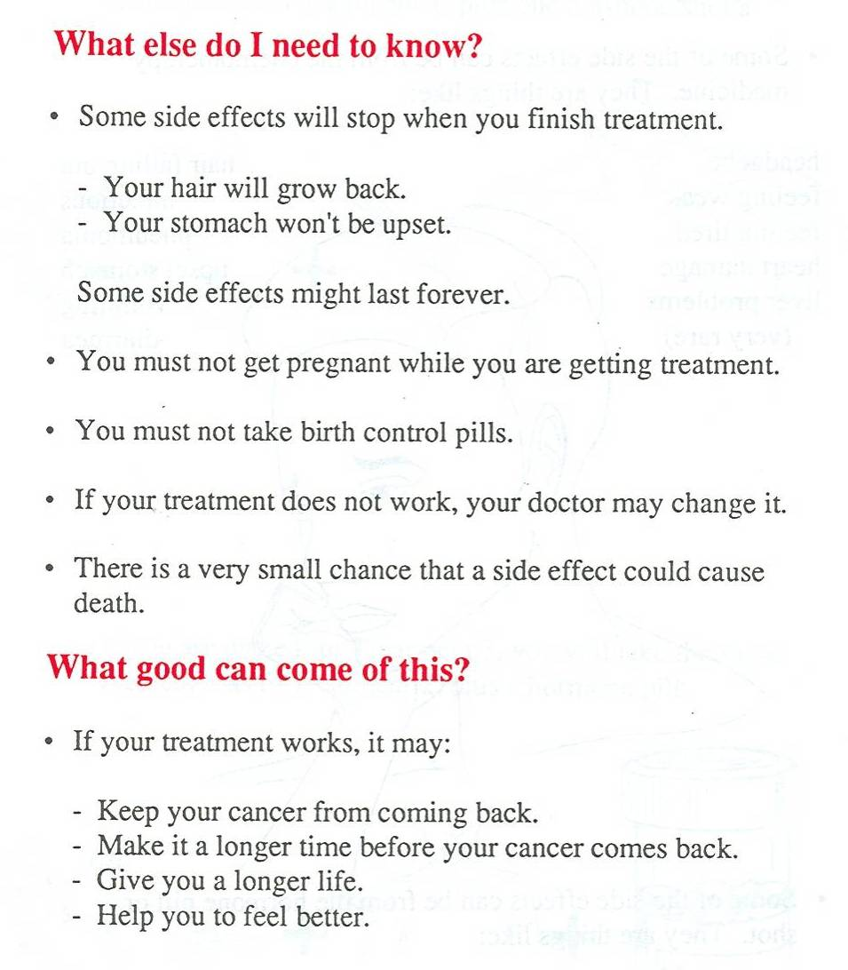
Layout & Reading Ease
Example of Improved Layout for Reading Ease
  White space
  Bullets, lists
  Bolding
  Simple headers
  Plain language
  Active voice
  Short sentences

Slide 13
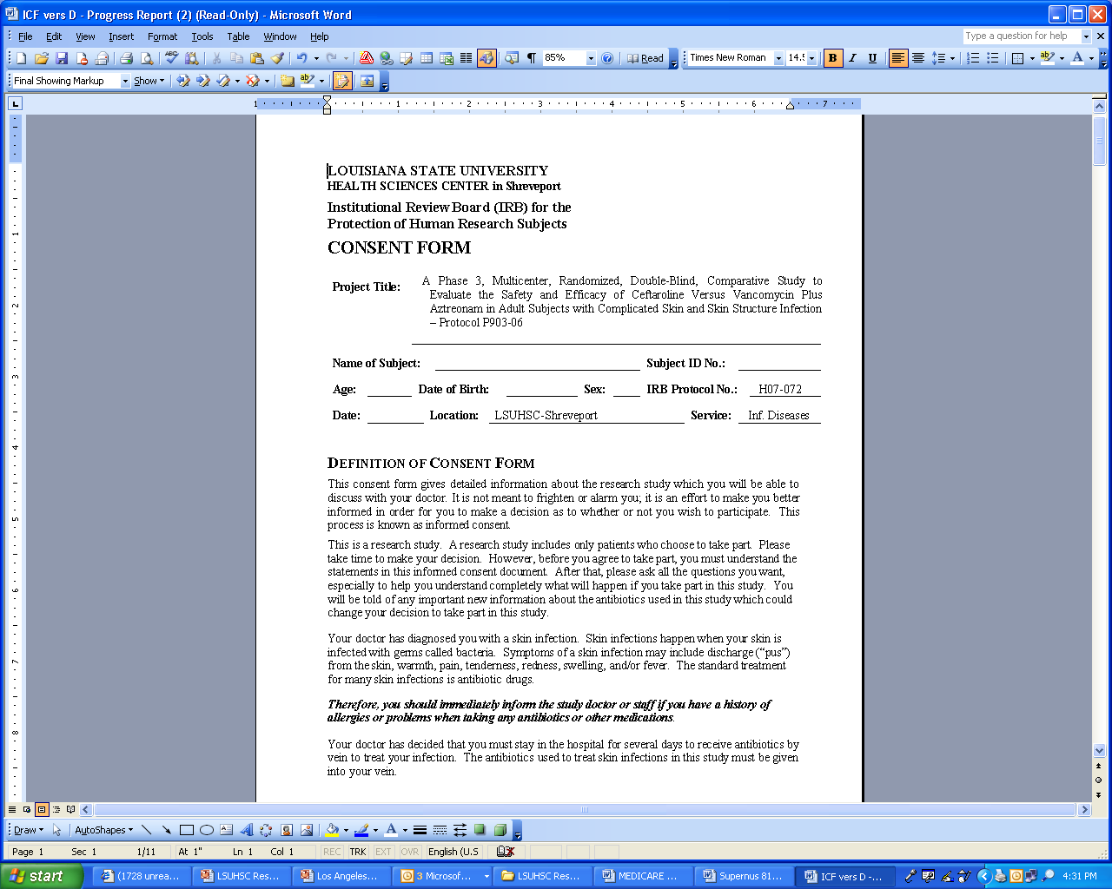
Note the Difference

Slide 14
Layout & Reading Ease
Illustrations Aid Reading Ease
  Pictures explain/enhance text
  If you use pictures:
    Locate them next to relevant text
    Place descriptive captions under images
  Note: color appeals to readers
The electrocardiogram (ECG, EKG) uses sensors on a person’s body to find out about how a person’s heart is working.
Image from http://www.umm.edu/patiented/articles/ecg_000172.htm

Slide 15
Document Design
Tips for Improving Document Design
  Use patient-centered title
  Break up text into manageable pieces
  Limit paragraphs to 3 or 4 lines
  One idea per short paragraph
Hochhauser, 2007

Slide 16
Example
Investigator-Centered vs. Patient-Centered Title
  Research Title
  Simplified Title
“Phase III Comparison of Combination Chemotherapy (CAF) & Chemohormonal Therapy (CAF + Zoladex and Tamoxifen) in Premenopausal Women with Axillary-Node Positive. Receptor-Positive Breast Cancer. Intergroup.”
“Breast Cancer. You Can Help Your Doctors Find Better Treatments.”

Slide 17
Example
Too Much Text (14 lines)
Researchers at X hope to learn what effects, good and/or bad, abiraterone acetate has on you and your prostate cancer. The effect of the prostate cancer will be measured by a blood test (prostatic specific antigen or PSA).
You are being asked to take part in this study because you have prostate cancer that is only partially responding to hormone therapy. Abiraterone acetate is a hormonal tablet that has been approved by the Food and Drug Administration (FDA) for more advanced prostate cancer patients who have received chemotherapy. It is considered investigational for your type of prostate cancer. We will be looking to see if abiraterone acetate improved the effectiveness of standard hormonal shots or injections. (The prostate specific antigen (PSA) is a blood test used in prostate cancer screening and also to follow prostate cancer. In this study, we will follow your PSA level to help determine if abiraterone acetate is beneficial. The main goal of this study is to see if abiraterone acetate with prednisone reduces PSA.

Slide 18
Example
Appropriate Text (3 lines)
Another goal of this study is to find out how the drugs used in this study affect menstrual cycles (monthly periods) and if these changes in menstrual cycles have any effect on breast cancer. You will be asked to allow blood samples to be collected as part of the study.

Slide 19
Example
Manageable Text (Bullets & Active Voice)
  Researchers at X hope to learn what effects, good and /or bad, abiraterone acetate has on you and your prostate cancer. We will measure the effect on your cancer with a blood test called PSA (prostatic specific antigen).
  We are asking you to take part in this study because you have prostate cancer that is only partially responding to hormone therapy.
  Abiraterone acetate is a hormonal tablet that has been approved by the FDA (Food and Drug Administration) for more advanced prostate cancer patients who have received chemotherapy. It is considered investigational for your type of prostate cancer.
  We will look to see if the hormone tablet improves the effectiveness of standard hormone shots or injections.
  We will follow your PSA level to find out if the hormone tablet is beneficial.

Slide 20
Consent Forms
Writing Consent Forms in Plain Language
  Use familiar words
  Define medical, legal or scientific words
  Use consistent terms throughout the form
  Use personal pronouns (I, you)
  Avoid abbreviations and acronyms
  Avoid words with 3 or more syllables (if possible)
NCI “Simplification of Informed Consent Documents”

Slide 21
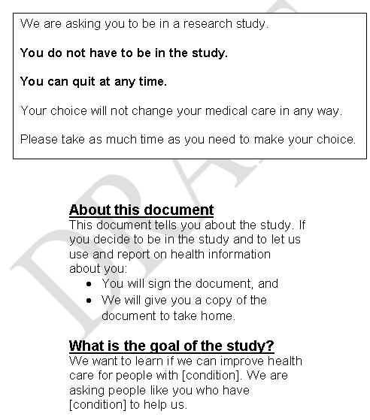
Check Understanding
Is the Information Manageable?
Does the document…
  Get to the point?
  Avoid information overload?
  Focus on “need to know” vs. “nice to know”?

Slide 22
Example
To-The-Point vs. Overloaded
The purpose of the study is to find out more about how the body controls BK virus.
The purpose of this study is to try to understand if production of BK virus, JC virus, Merkel Cell Polyomavirus and Cytomegalovirus vary with hormonal changes during the female menstrual cycle. The study will also test your immune response to BK virus, JC virus, Merkel Cell Polyomavirus and Cytomegalovirus, if present, and measure hormone levels in urine for correlation with your menstrual cycle.

Slide 23
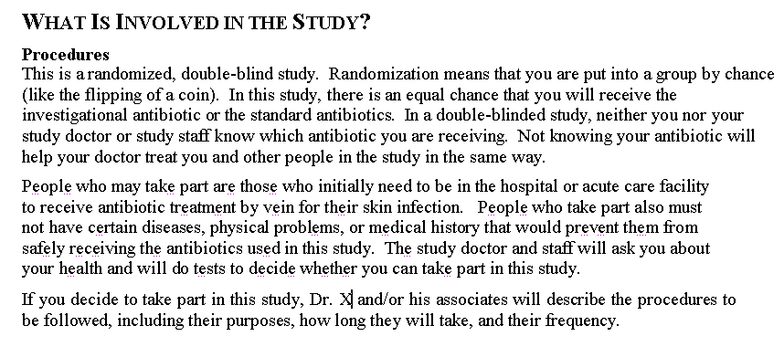
Consent Forms
Are Key Messages Clear?
  Are key messages buried?
  Are words commonly understood or jargon?
The consent form below is NOT clear

Slide 24
Example
Clear vs. Buried Messages
The goal of this research is to learn what makes cells turn into cancer.
The goal of the tissue bank or repository is to support the LSUHSC-S Dept. of Surgery research in order to improve our understanding of those molecular factors that contribute to cancer and that may lead to prevention, early detection, and cure.

Slide 25
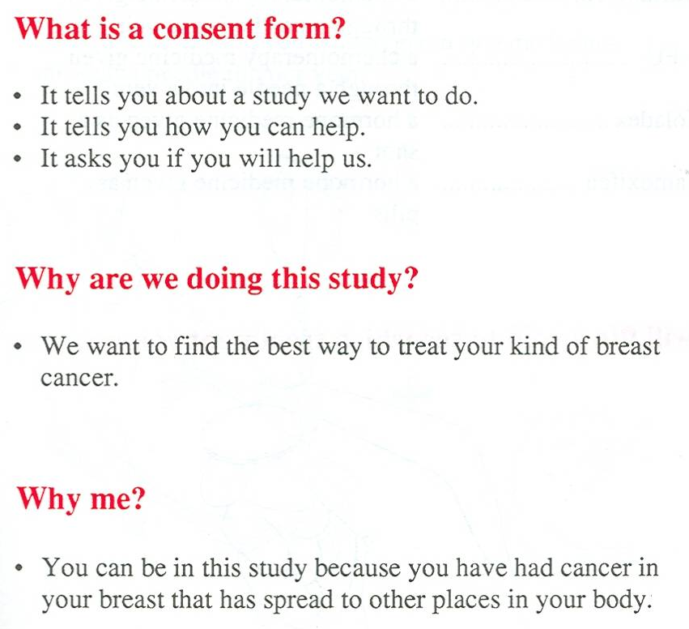
Consent Forms
Is Tone Bureaucratic or Patient-Centered?
Does the document…
  Focus on the study or also consider the patient?
  Have a respectful, conversational tone?
  Address the reader by using personal pronouns?

Slide 26
Consent Forms
A Fun Way for Spotting Difficult Words
  Vocabulary Profiler color codes words in English
  1000 most frequently used words (K1)
  Second 1000 frequently used words (K2)
  Academic words frequently used in academic texts (AWL)
  Words which are not found on the other lists (off list)

Slide 27
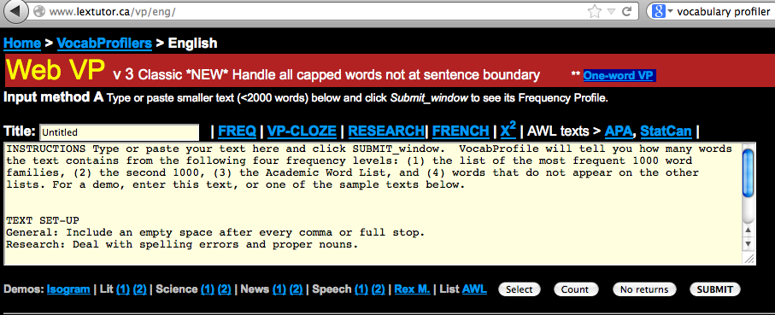
Recommendation
We recommend using www.lextutor.ca/vp/eng

Slide 28
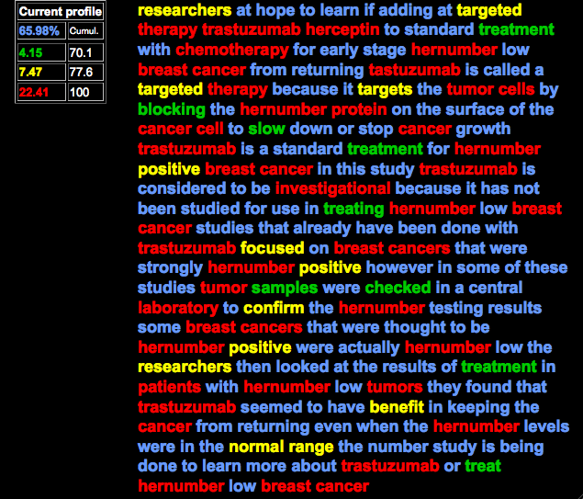
Red & Yellow Warn You

Slide 29
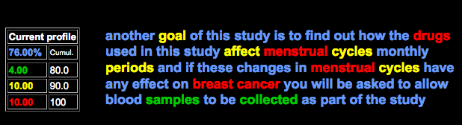
Vocabulary Profiler
Example of Using Vocabulary Profiler to Simplify
  Another goal of this study is to find out how the drugs used in this study affect menstrual cycles (monthly periods) and if these changes in menstrual cycles have any effect on breast cancer. You will be asked to allow blood samples to be collected as part of the study.

Slide 30
User-Friendly Forms
How to Develop User-Friendly Forms
  It’s not rocket science but it’s harder and more tedious than it seems
  User friendly does not mean ‘dumbed down’
  Patients with high education and income still prefer brief, simple, easy to read materials
Pilot Testing
  Ask for feedback to limit jargon and increase comprehension
  First, from friends (outside the field)
  Second, from patients

Slide 31
Plain Language Thesaurus
Here are some words to assist in simplifying consent forms
  Acknowledged → Accepted, Recognized
  Adverse Events → Bad Reaction
  Alternative → Choice
  Alternative procedures → Other Choices
  Amend → Change

Slide 32
Plain Language Thesaurus
Here are some words to assist in simplifying consent forms
  Authorization → Your “ok” in writing
  Benefit → Will being in this study help me in any way
  Clinical Trial → Research Study
  Control Group/Aim → People not getting the new treatment
  Determine → Decide, Find Out
  Disclosure → Information you give to us

Slide 33
Plain Language Thesaurus
Here are some words to assist in simplifying consent forms
  Experimental Group → People getting new treatment
  Hereby/herein → In this (or just don’t use)
  Notify → Tell us/Tell you
  Obtain → Get, get a copy
  Placebo → A pretend drug or treatment, sugar pill

Slide 34
Plain Language Thesaurus
Here are some words to assist in simplifying consent forms
  Protocol → Plan for a research study
  Procedure → Way of doing things
  Randomized → Selected by chance
  Risk
  Voluntary Participation → It’s your choice to be in this study
  Withdrawal from the study → You can leave the study

Slide 35
Issues
Hidden Problems With Videos
  Often too long (limit to 4-6 minutes)
  Too much time with “talking heads”
  Not patient-centered
  Visuals can be too scientific, complex
  Need to show what will happen
  Lack of attention to ‘tone’, patient emotions
Multi-media tools have not improved comprehension over print media

Slide 36
Review
Review of Studies to Improve Informed Consent
  Shortened forms may be more likely to be read
  Simplified consent forms improve patient satisfaction but not comprehension
  Multimedia has not improved comprehension
  Consent educator using repetition and ‘teach back’ has promising results

Slide 37
Informed Consent
Improving Informed Consent Process
  Give patient time to go over the form before you talk about it
  Talk about the form in a private place
  Let the patient include who they wish
  Offer to read the document with the patient
  Slow down
  Use plain language – avoid jargon
  Verify and document comprehension

Slide 38
Informed Consent
Why verify understanding?
  Most patients are passive and don’t ask questions
  Unless we confirm understanding we don’t know what they comprehend
Check understanding using the Teach-Back Method
  Use teach-back after each section or two to confirm understanding
  Use your own words with an interested (vs. judgmental) tone
  Avoid asking:
    Do you understand?
    Do you have any questions?
Remembers – what’s clear to you may not be clear to your patient!

Slide 39
Teach Back
Teach Back is Effective
  Ask open-ended questions:
  Goal of the Research and Protocol
    “Why are we doing this research?” “What is the study about?”
    “What will you be doing if you agree to be in this study?”
  Benefits and Compensation
    “Will being in this study help you in any way?”
  Risks
    “Is there any way being in this study will be bad for you or hurt you?”
AHRQ, 2008; See handout

Slide 40
Teach Back
Teach Back is Effective
  Voluntariness
    “Can you decide you do not want to be in the study?”
    “Will that change your healthcare?”
  Discontinuing Participation
    “What should you do if you change your mind?”
    “What will happen to information we have gotten if you change your mind?”
  Privacy
    “Who will be able to see the information you give us?”
  Contact Information
    “What should you do if you have any questions or concerns about the study?
AHRQ, 2008; See handout

Slide 41
Teach Back
Teach Back is Effective
  Allow the subjects to consult the document when answering
  The purpose is to check comprehension not memory
  Verify & Document
    Correct misinformation
    Subjects who are not able to comprehend the study protocol, despite repeated attempts to explain the details, should not be enrolled
    Document completion of the teach-back process on a consent and authorization certification form
AHRQ, 2008; See handout

Slide 42
Summary
Consent Document
  Aim for <8th grade level
  Write and format for reading ease
  Limit jargon – use consistent terms
  Pilot test with a few patients
Consent Process
  Use teach back to confirm understanding
  Make it friendly
  Remember that participation is the patient’s choice
Notes:
.

Slide 43
Responses
Responses to Objections to Making Process More Understandable
  Legal clauses need to protect our institution against lawsuits
    Making informed documents incomprehensible does not afford protection against lawsuits*
    There has been no successful case against researchers because the consent form did not use technical language
  Regulations require technical terms
    Regulations support the use of plain language
*Diaz vs. Hillsborough County Hospital Authority, 2000
$3.8 M class action – failure of consent, form too complicated

Slide 44
Responses
Responses to Objections to Making Process More Understandable
  Small font, long paragraphs to keep the documents short
    Large font, lots of white space, and headings to break text into manageable pieces make documents easier to read than short, dense documents
    Well done documents do not have to be too long
  Most people are familiar with medical terms
    Most adults do not understand medical terms
  We have used these documents for years. Subjects wouldn’t sign if they didn’t understand
    Research shows most subjects do not understand all information contained in the consent documents that they sign

Slide 45
Responses
Responses to Objections to Making Process More Understandable
  It will take too long to verify comprehension
    Assessing comprehension can identify subjects who need further instruction or who will not be able to participate
  There is no reason to focus on written materials because informed consent is a process and investigators will communicate what is needed
    High quality consent materials can lead to an improved consent process and provide information that subjects can refer to later.

Slide 46
DHHS Resources
The Agency for Healthcare Research and Quality (AHRQ) Informed Consent and Authorization Toolkit for Minimal Risk Research.
First Clinical Research Glossary for Informed Consent:
http://firstclinical.com/icfglossary/
http://firstclinical.com/glossary/

Slide 47
Other Resources
Doak CC, Doak LG, Root JH. Teaching Patients With Low Literacy Skills, 2nd ed., 1996
Simply Put “ A Guide for Creating Easy to Read Print Materials that you audience will be able to read an use. CDC 2007.
Special thanks for information about vocabulary profiler:
  Boyd H. Davis, PhD.
  Professor, Applied Linguistics/English
  UNC Charlotte

